Slide 1
Homework 3
Simulation of Complex Systems
Francisco Caetano

Slide 2
Exercise 1
Plot that shows sample trajectories with different values of swimming velocity
Plot that shows mean square displacement resulting from each trajectory

Slide 3
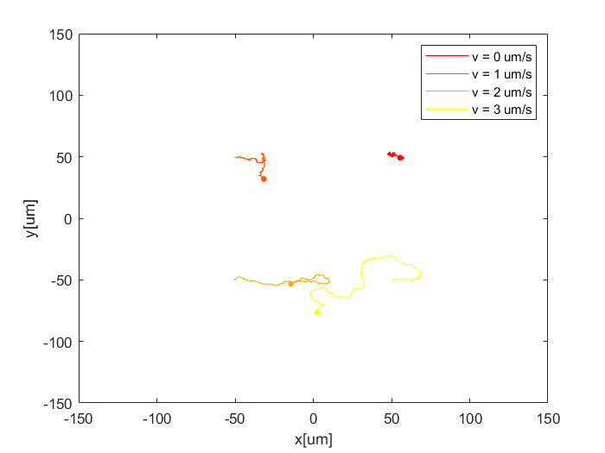
Trajectory for different velocities

Slide 4
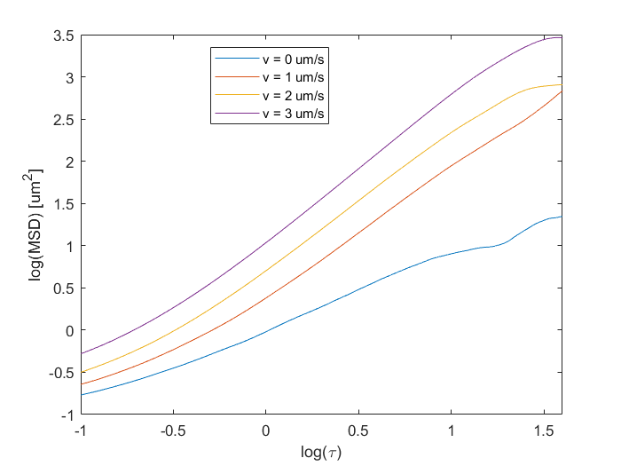
Mean Square Displacement

Slide 5
Exercise 2
Plot some sample screen shots of the simulation with different cluster sizes
Prepare an animated video like the sample video

Slide 6
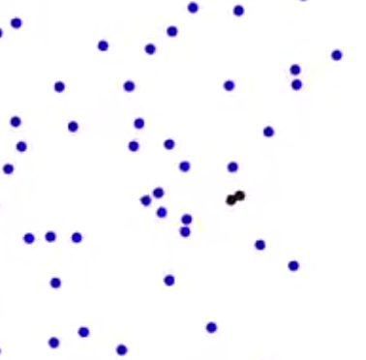
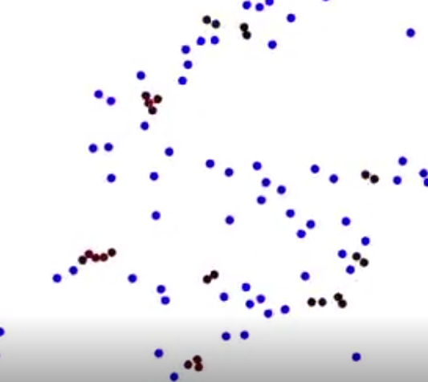
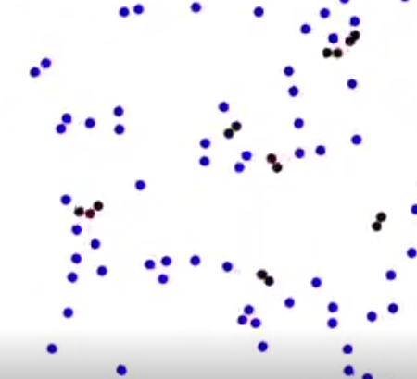
Screen Shots
Almost nO clusters
Some clusters
Big Clusters

Slide 7
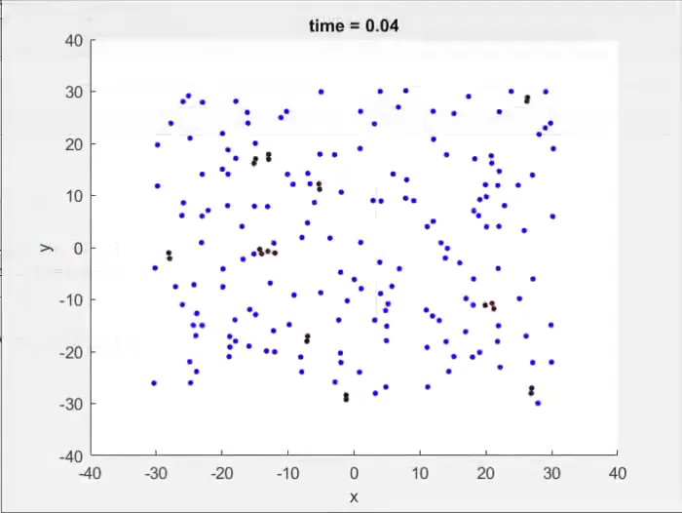
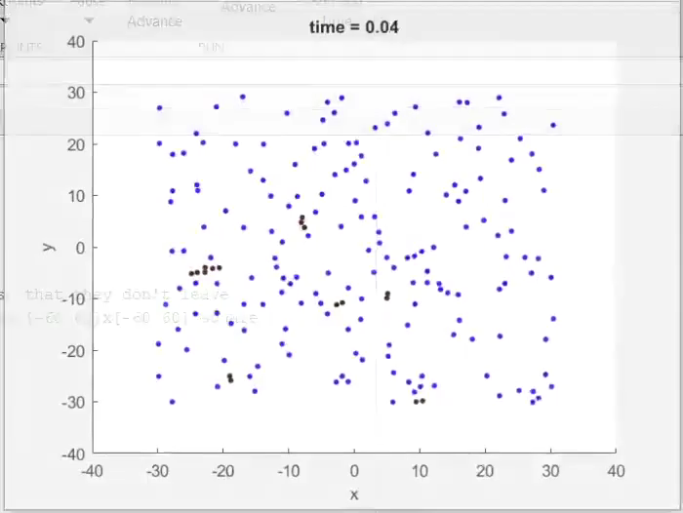
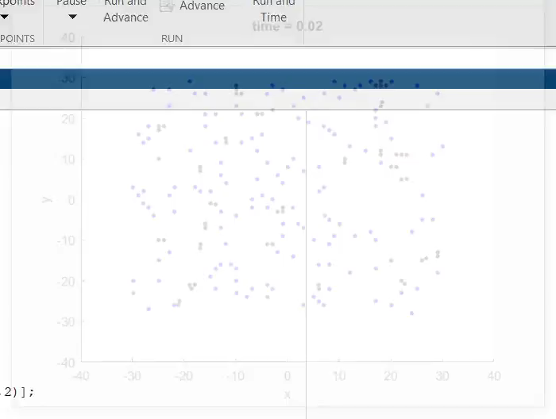
Video
Almost nO clusters
Some clusters
Big Clusters

Slide 8
Exercise 3
Create the model and find correct parameters to observe metastable channels

Slide 9
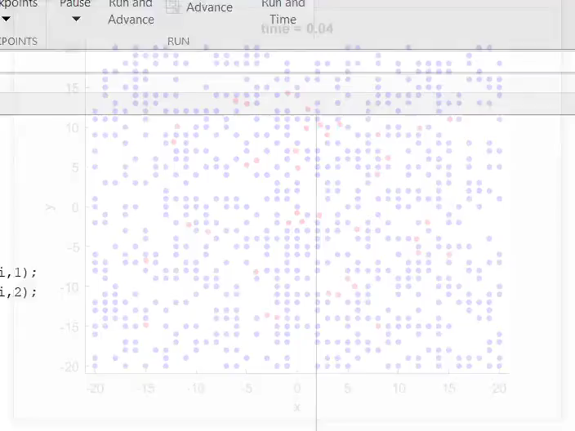
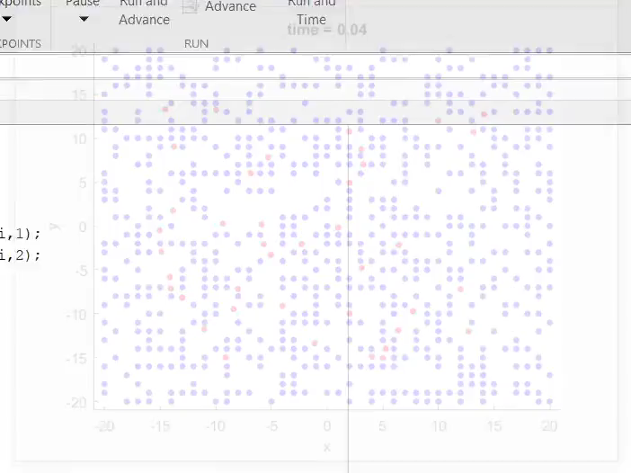
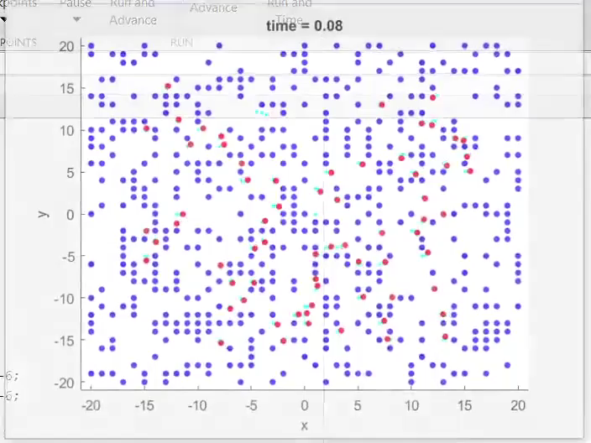
Video
No Channels
They start forming
Clear Channels

